Slide 1
Alarms and Schedulers
Android Developer Fundamentals V2
Lesson 8

Slide 2
8.3 Efficient data transfer and JobScheduler

Slide 3
Contents
Transferring Data Efficiently
Job Scheduler
JobService
JobInfo
JobScheduler

Slide 4
Transferring Data Efficiently

Slide 5
Transferring data uses resources
Wireless radio uses battery.
Device runs out of battery.
Need to let device charge.
Transferring data uses up data plans.
Costing users real money (for free apps…).

Slide 6
Wireless radio power states
Full power—Active connection, highest rate data transfer.
Low power—Intermediate state that uses 50% less power.
Standby—Minimal energy, no active network connection.

Slide 7
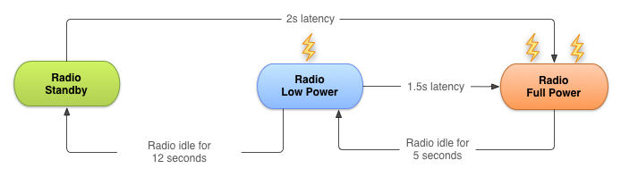
Wireless radio state transitions for 3G

Slide 8
Bundle network transfers
For a typical 3G device, every data transfer session, the radio draws energy for almost 20 seconds.
Send data for 1s every 18s—radio mostly on full power.
Send data in bundles of 3s—radio mostly idle.
Bundle your data transfers.

Slide 9
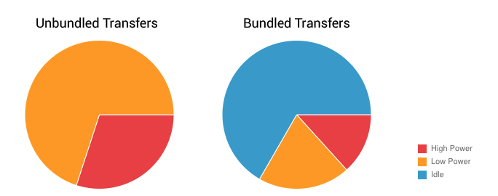
Bundled vs. unbundled

Slide 10
Prefetch data
Download all the data you are likely to need for a given time period in a single burst, over a single connection, at full capacity.
If you guess right, reduces battery cost and latency.
If you guess wrong, may use more battery and data bandwidth.

Slide 11
Monitor connectivity state
Wi-Fi radio uses less battery and has more bandwidth than wireless radio.
Use ConnectivityManager to determine which radio is active and adapt your strategy.

Slide 12
Monitor battery state
Wait for specific conditions to initiate battery intensive operation.
BatteryManager broadcasts all battery and charging details in a broadcast Intent.
Use a BroadcastReceiver registered for battery status actions.

Slide 13
Job Scheduler

Slide 14
What is Job Scheduler
Used for intelligent scheduling of background tasks.
Based on conditions, not a time schedule.
Much more efficient than AlarmManager.
Batches tasks together to minimize battery drain.
API 21+ (not in support library).

Slide 15
Job Scheduler components
JobService—Service class where the task is initiated.
JobInfo—Builder pattern to set the conditions for the task.
JobScheduler—Schedule and cancel tasks, launch service.

Slide 16
JobService

Slide 17
JobService
JobService subclass, implement your task here.
Override
onStartJob()
onStopJob()
Runs on the main thread.
Notes:
off load your work

Slide 18
onStartJob()
Implement work to be done here.
Called by system when conditions are met.
Runs on main thread.
Off-load heavy work to another thread.

Slide 19
When does a JobService finish?
onStartJob() returns a boolean
FALSE—Job finished.
TRUE
Work has been offloaded.
Must call jobFinished() from the worker thread.
Pass in JobParams object from onStartJob().
Notes:
Talk about rescheduling with jobfinished

Slide 20
onStopJob()
Called if system has determined execution of job must stop.
… because requirements specified no longer met.
For example, no longer on Wi-Fi, device not idle anymore.
Before jobFinished(JobParameters, boolean).
Return TRUE to reschedule.

Slide 21
Basic JobService code
public class MyJobService extends JobService { private UpdateAppsAsyncTask updateTask = new UpdateAppsAsyncTask(); @Override public boolean onStartJob(JobParameters params) { updateTask.execute(params); return true; // work has been offloaded }
@Override
public boolean onStopJob(JobParameters jobParameters) {
return true;
}
}

Slide 22
Register your JobService
<service
android:name=".NotificationJobService"
android:permission=
"android.permission.BIND_JOB_SERVICE"/>

Slide 23
JobInfo

Slide 24
JobInfo
JobInfo
Set conditions of execution.
JobInfo.Builder object.

Slide 25
JobInfo builder object
Arg 1: Job ID
Arg 2: Service component
Arg 3: JobService to launch
JobInfo.Builder builder = new JobInfo.Builder( JOB_ID, new ComponentName(getPackageName(), NotificationJobService.class.getName()));

Slide 26
Setting conditions
setRequiredNetworkType(int networkType)
setBackoffCriteria(long initialBackoffMillis, int backoffPolicy)
setMinimumLatency(long minLatencyMillis)
setOverrideDeadline(long maxExecutionDelayMillis)
setPeriodic(long intervalMillis)
setPersisted(boolean isPersisted)
setRequiresCharging(boolean requiresCharging)
setRequiresDeviceIdle(boolean requiresDeviceIdle)

Slide 27
setRequiredNetworkType()
setRequiredNetworkType(int networkType)
NETWORK_TYPE_NONE—Default, no network required.
NETWORK_TYPE_ANY—Requires network connectivity.
NETWORK_TYPE_NOT_ROAMING—Requires network connectivity that is not roaming.
NETWORK_TYPE_UNMETERED—Requires network connectivity that is unmetered.

Slide 28
setMinimumLatency()
setMinimumLatency(long minLatencyMillis)
Minimum milliseconds to wait before completing task.

Slide 29
setOverrideDeadline()
setOverrideDeadline(long maxExecutionDelayMillis)
Maximum milliseconds to wait before running the task, even if other conditions aren't met.

Slide 30
setPeriodic()
setPeriodic(long intervalMillis)
Repeats task after a certain amount of time.
Pass in repetition interval.
Mutually exclusive with minimum latency and override deadline conditions.
Task is not guaranteed to run in the given period.

Slide 31
setPersisted()
setPersisted(boolean isPersisted)
Sets whether the job is persisted across system reboots.
Pass in True or False.
Requires RECEIVE_BOOT_COMPLETED permission.

Slide 32
setRequiresCharging()
setRequiresCharging(boolean requiresCharging)
Whether device must be plugged in.
Pass in True or False.
Defaults to False.

Slide 33
setRequiresDeviceIdle()
setRequiresDeviceIdle(boolean requiresDeviceIdle)
Whether device must be in idle mode.
Idle mode is a loose definition by the system, when device is not in use, and has not been for some time.
Use for resource-heavy jobs.
Pass in True or False. Defaults to False.

Slide 34
JobInfo code
JobInfo.Builder builder = new JobInfo.Builder( JOB_ID, new ComponentName(getPackageName(), NotificationJobService.class.getName()))
.setRequiredNetworkType(JobInfo.NETWORK_TYPE_UNMETERED)
.setRequiresDeviceIdle(true)
.setRequiresCharging(true);
JobInfo myJobInfo = builder.build();

Slide 35
JobScheduler

Slide 36
Scheduling the job
Obtain a JobScheduler object form the system.
Call schedule() on JobScheduler, with JobInfo object.
mScheduler =
(JobScheduler)getSystemService(JOB_SCHEDULER_SERVICE);
mScheduler.schedule(myJobInfo);

Slide 37
Resources
Transferring Data Without Draining the Battery Guide
Optimizing Downloads for Efficient Network Access Guide
Modifying your Download Patterns Based on the Connectivity Type Guide
JobScheduler Reference
JobService Reference
JobInfo Reference
JobInfo.Builder Reference
JobParameters Reference
Presentation on Scheduling Tasks

Slide 38
What's Next?
Concept Chapter: 8.3 Efficient data transfer
Practical: 8.3 Job Scheduler

Slide 39
END

